Slide 1
SDL Miniproject
Class : TE 2
Batch : L2

Slide 2

Project Description
Title
STICKY NOTES
Team Members
Shreejay Jahagirdar - 31223
Vedant Joshi - 31224
Amit Kore - 31231
Nikhil Kulkarni - 31233

Slide 3
Motivation
An app to store multiple users’ notes, generally 1 notes app is usable only for 1 user without any security, here we have enabled a mandatory google sign in button so only authorized people will have access with an additional feature of tasks provided and a reminder to display notification on the time set.

Slide 4
Requirement Gathering & Analysis
SR NO | FUNCTIONALITIES | REQUIREMENT OF FUNCTIONALITIES | ANALYSIS
1 | Access to Notes | Restricted access through google account only | Possible
2 | User Profile | User Profile along name and email ID should be displayed when signed in and also whenever requested by user | Possible
3 | Create/Update/Delete Notes | All functionalities related to creation, edit, and deletion of notes are required | Possible
4 | Creation of Notes | Subject mandatory, no limitation of text count, only text allowed with special characters | Possible
5 | Edit of notes | Editing is possible for text and title | Possible
6 | Deletion of notes | Provision required to delete the notes completely | Possible
7 | Text Editing | Highlight the text, bold font, special formatting functions are required | Formatting text functionality can be considered for future scope
8 | Autosaving of notes | Note should be saved only when clicked on request of user | Autosaving can be considered for future scope
9 | Sorting of notes | Sorting should be possible based on title text and date of creation in both ascending and descending order | Possible
10 | Create/Update/Delete Tasks | All functionalities related to creation, edit, and deletion of tasks are required | Possible
11 | Creation of tasks | Only Task name is required, only text allowed with special characters, user should be able to set a reminder with date and time in the form of notification | Possible
12 | Edit of tasks | Editing should be possible for task name and reminder date and time, task will be edited only after user confirmation | Possible
13 | Deletion of tasks | Provision required to delete the task completely, comfirmation by user required while deletion | Possible
14 | Task List Display | Tasks should be displayed based on sorting by task name and creation date in both ascending and descending order | Sorting based on creation date is possible. Sorting based on task name can be provided for future scope

Slide 5
Problem Statement
Design an android application in which authorized users can create, store & edit notes or tasks or both.

Slide 6
Requirements
Hardware
PC with core i5
8GB RAM
512GB ROM
15'' Monitor
Keyboard
Mouse
Software
Windows 10 OS
Android Studio(Version 4.1)
Frontend Java

Slide 7
Algorithm
A] Google API
https://developers.google.com/identity/sign-in/android/sign-in

Slide 8
B] Notes
1)Create a new note
2)Add title
3)Add description
4)Save it
5)Tap on the note to go into editing
6)Click delete icon to delete the note
7) Click on Edit button to edit the contents in the note.
8) Update the Title & Description as needed.
9) Click on Save button to Save the updated note.
10)End

Slide 9
C] Task
1)Create a new task
2)Set a reminder if you want to
3)Save it
4)Swipe right to edit
5)Swipe left to delete
5.1)Confirm if you want to delete
//Note deleted
6)End

Slide 10
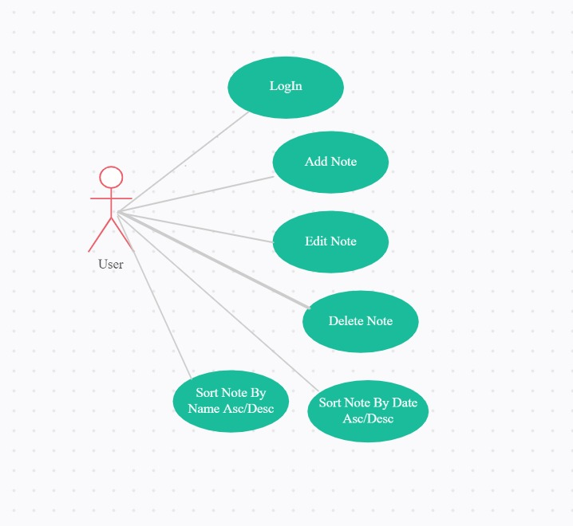
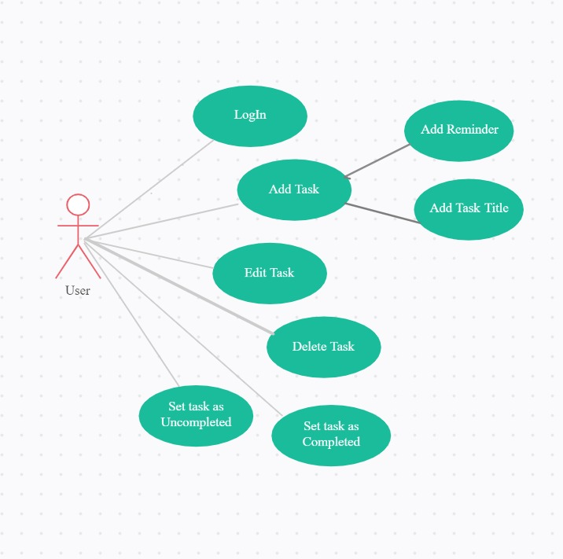
Use Case
Task
Notes

Slide 11
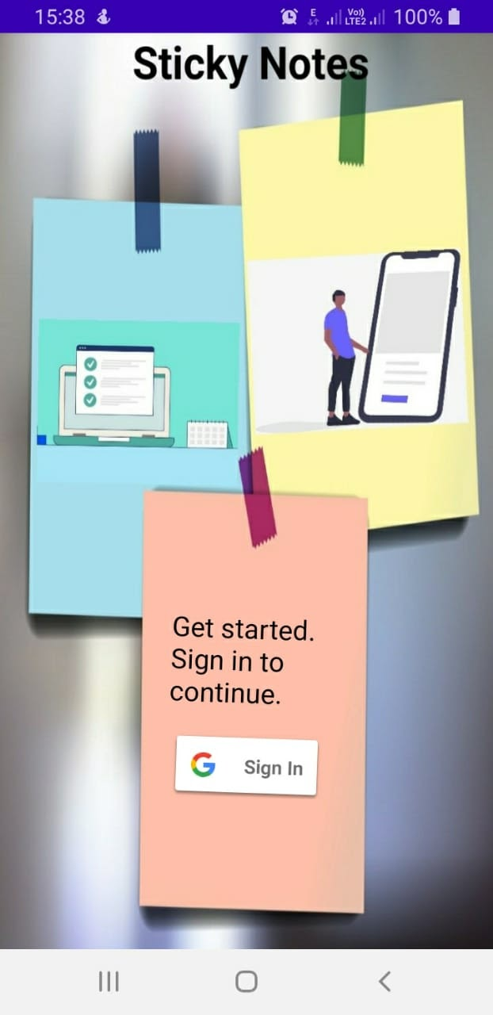
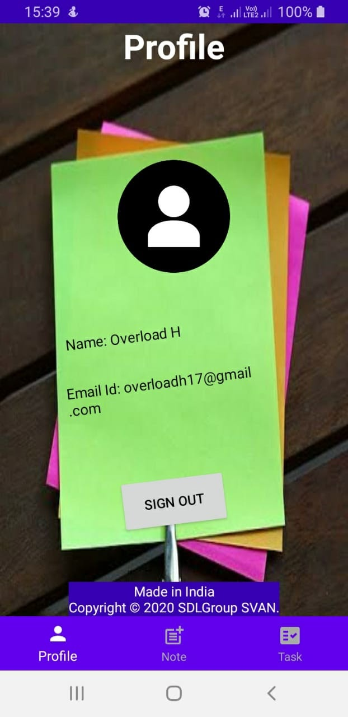
Screenshots
Sign In

Slide 12
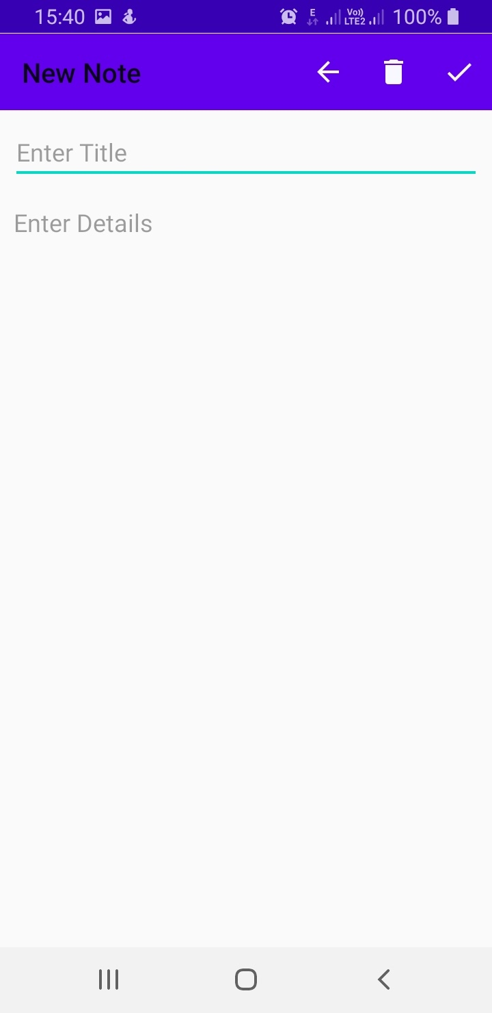
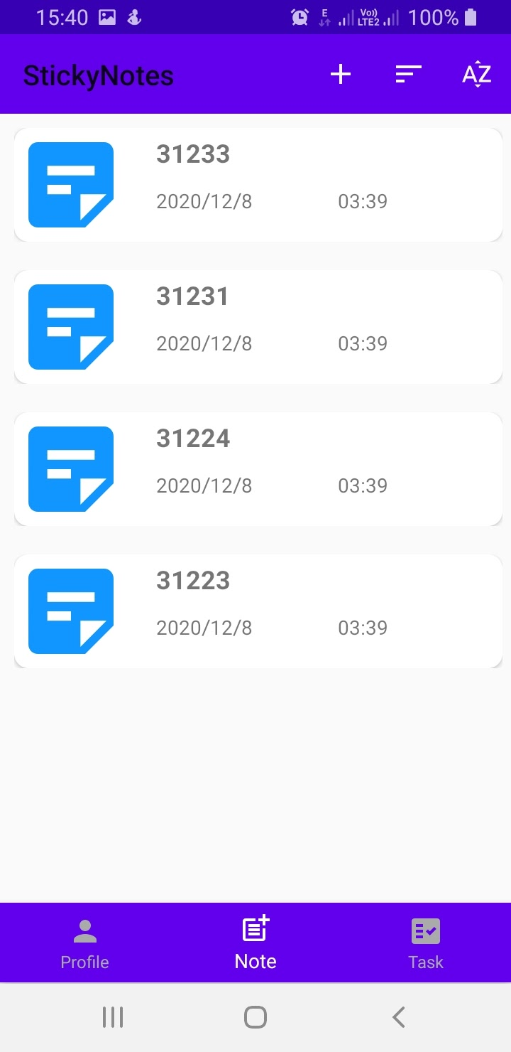
Add a Note

Slide 13
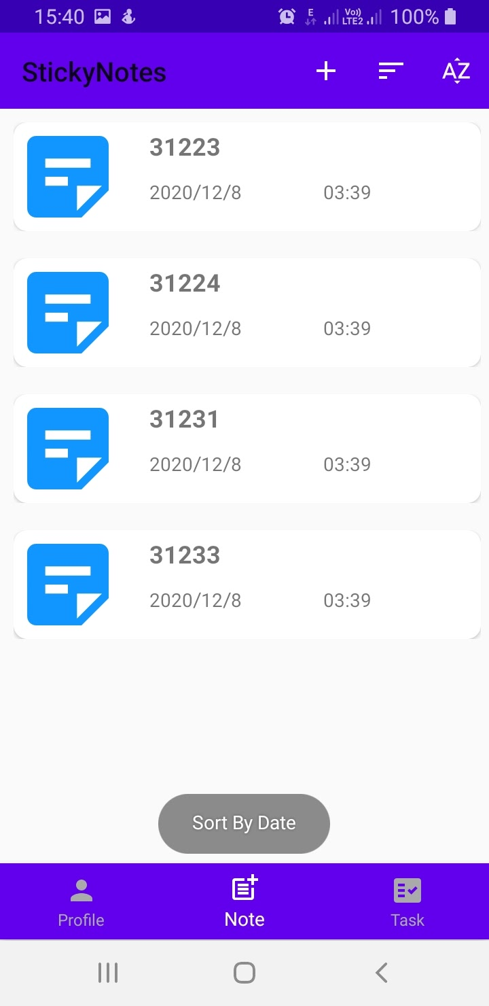
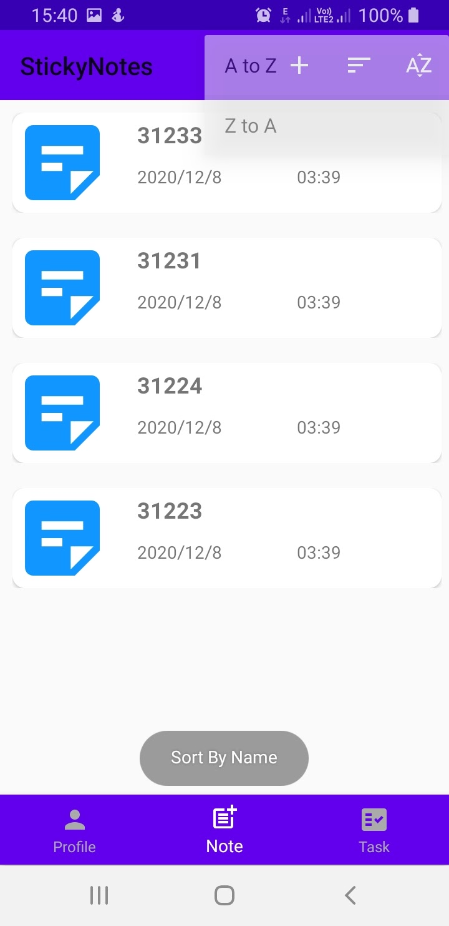
Sort the Notes

Slide 14
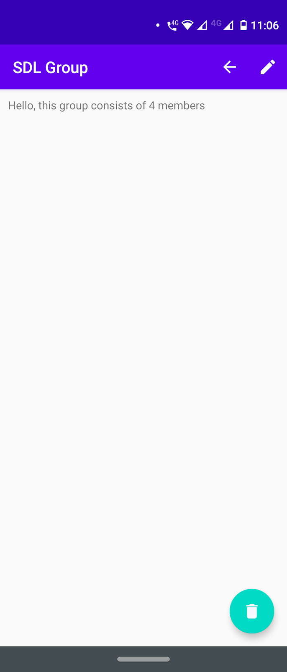
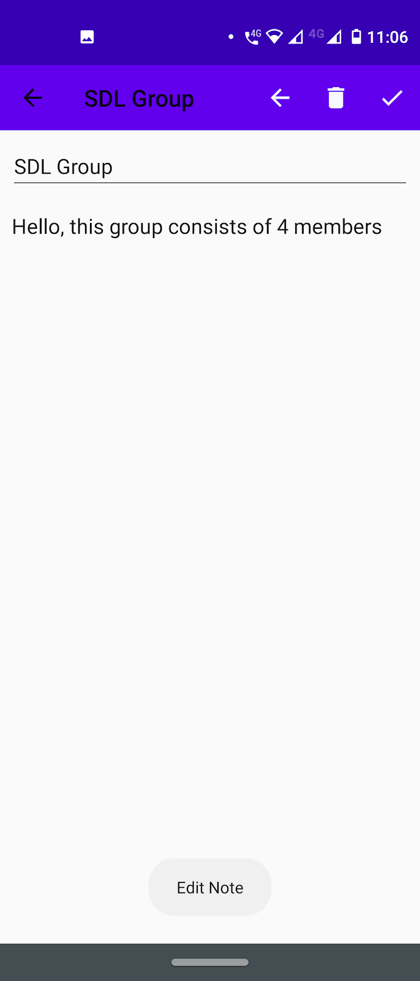
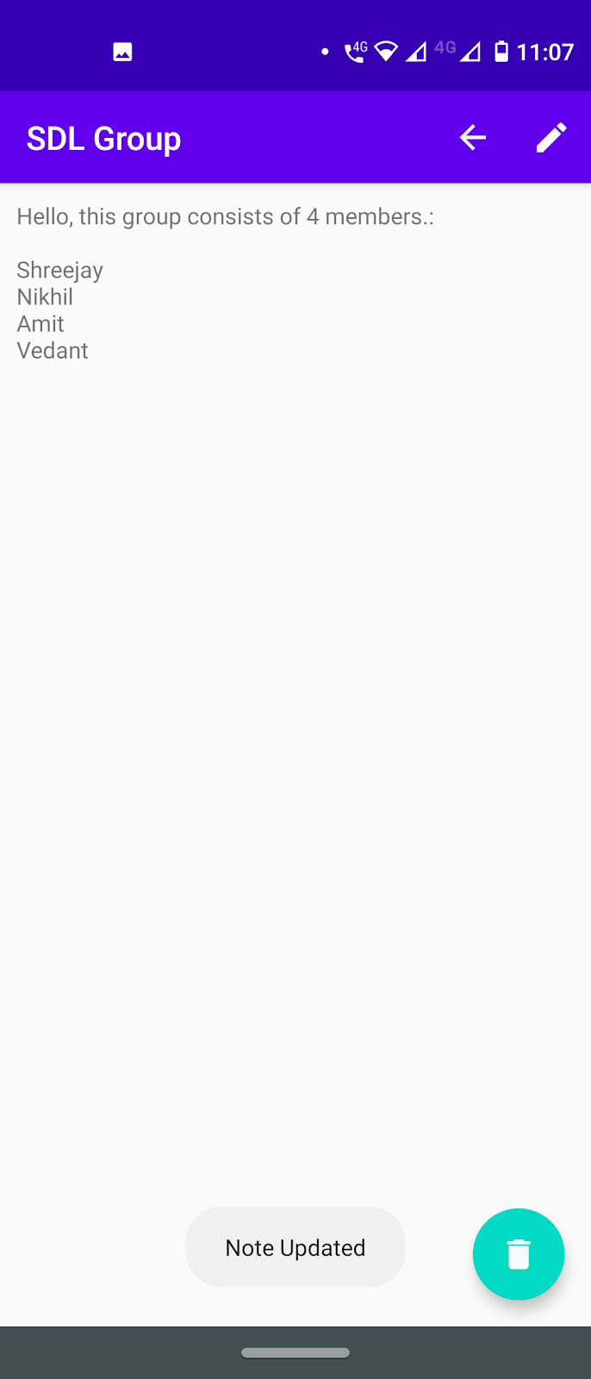
Edit a Note

Slide 15
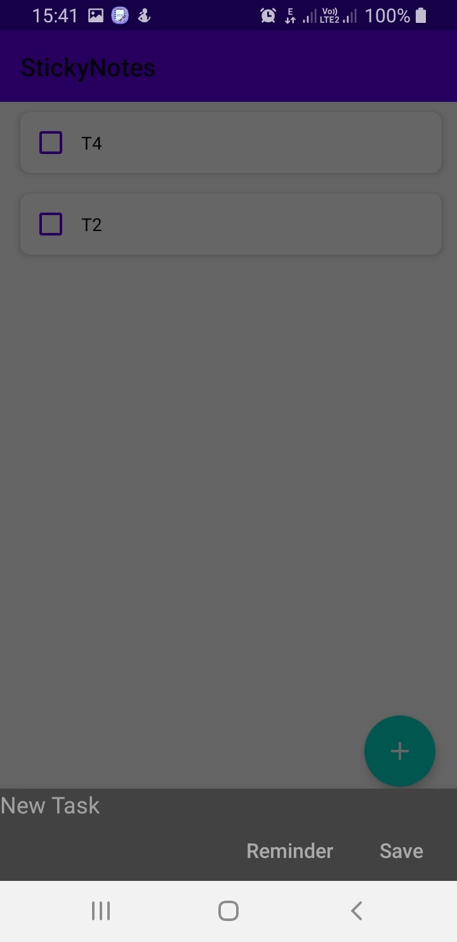
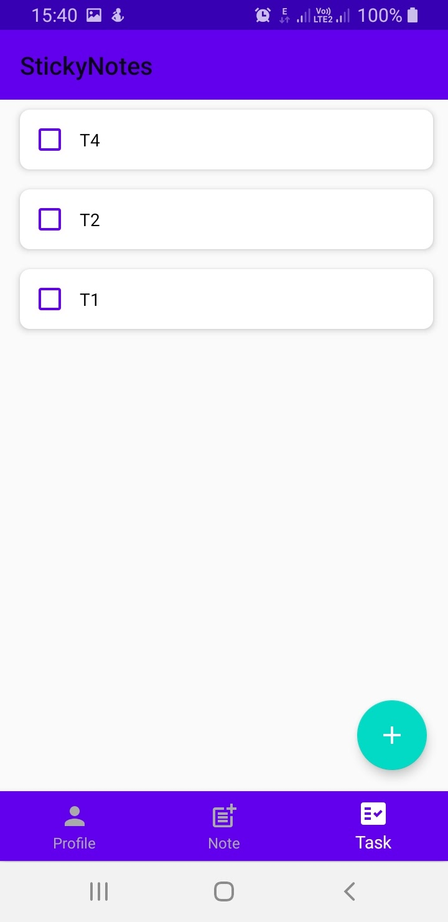
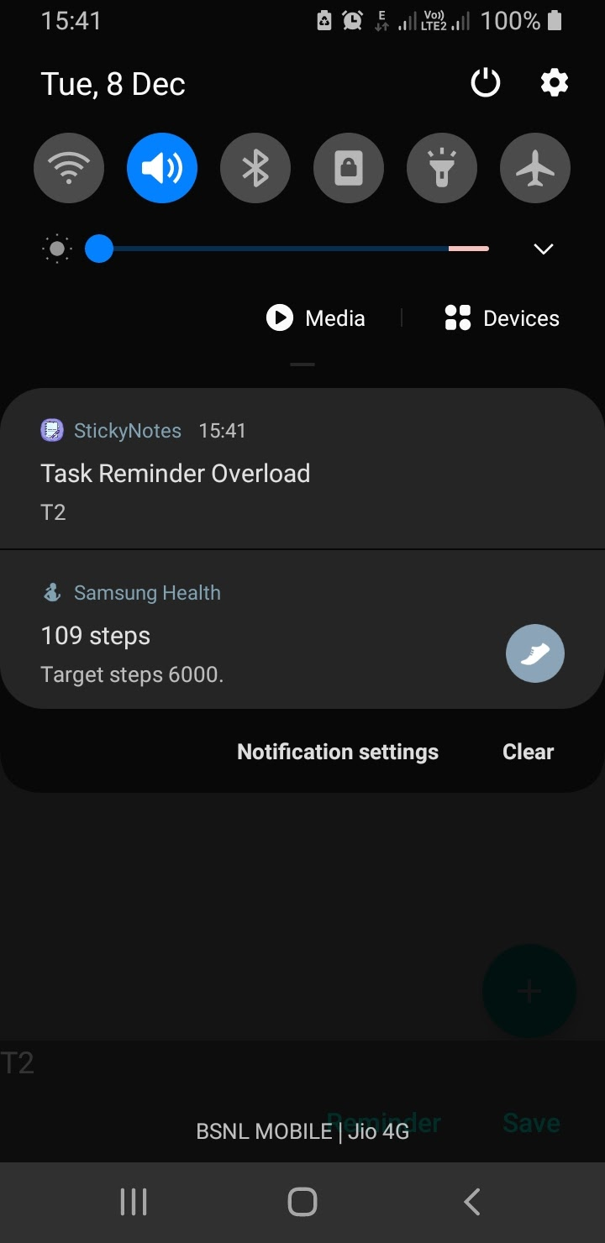
Add a Task

Slide 16
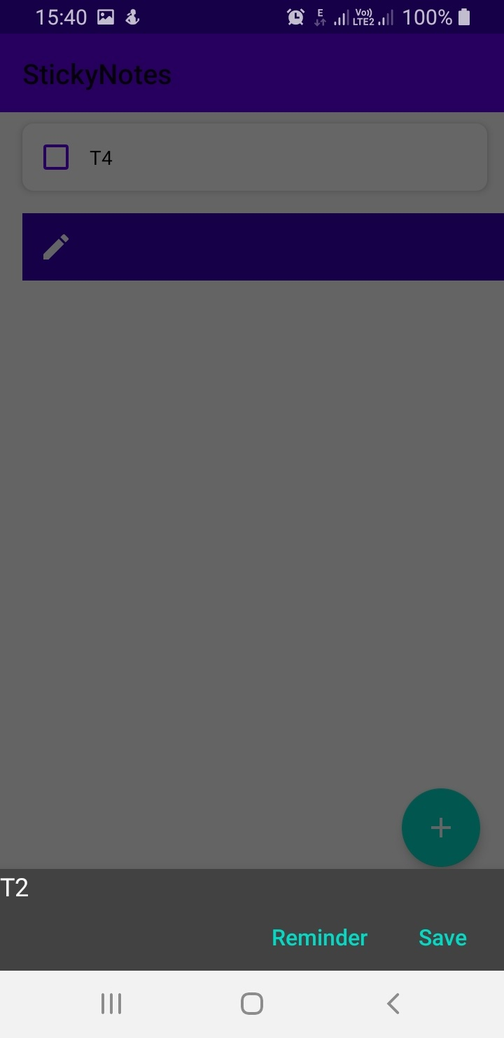
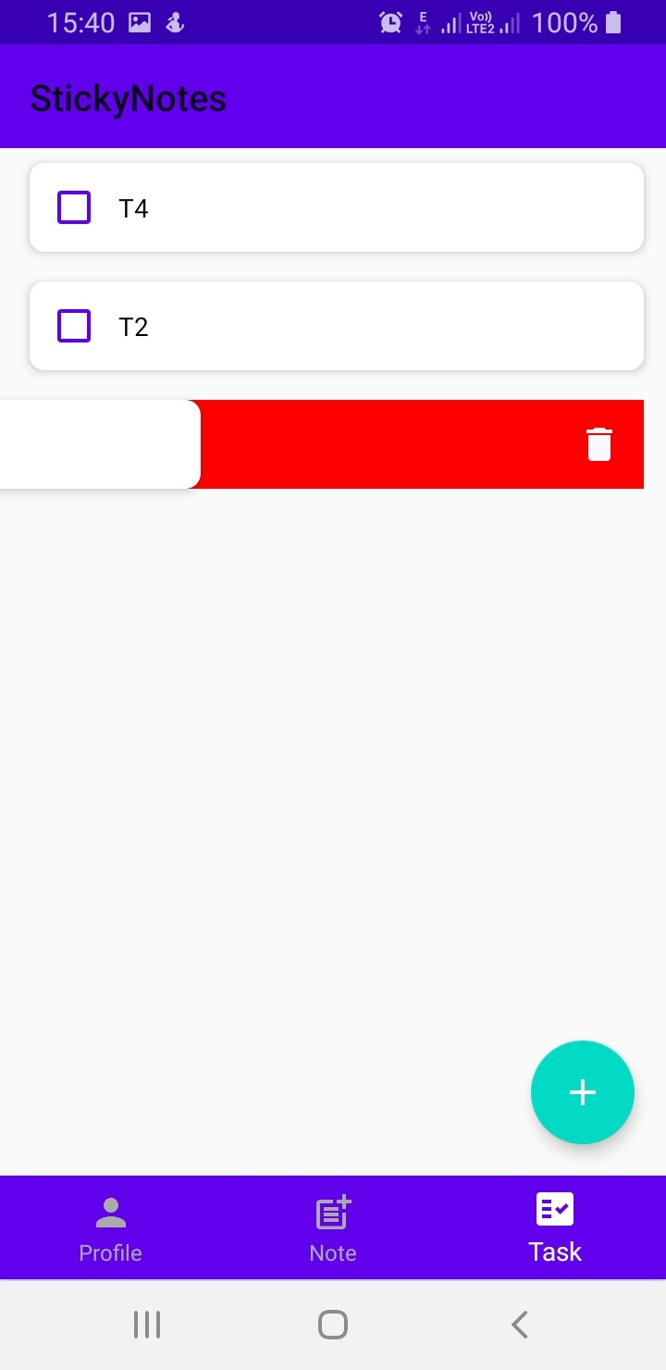
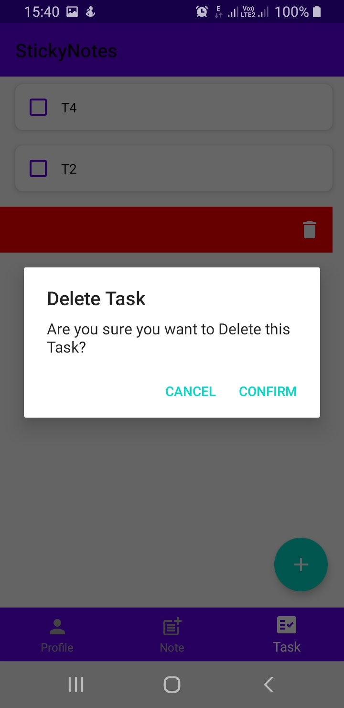
Edit and Delete a Task

Slide 17
Conclusion
The main goals & objectives behind the development of the Sticky Notes Android Application were analyzed & implemented, & the following 3 core objectives were accomplished :-
Learning of Android Development through use of available resources to an extent where a mobile application ready for deployment can be produced.
Producing a secure application for creating & managing the notes & tasks.
Evaluation of overall effectiveness of application & its usability by the users.

Slide 18
Future Scope
A lot of improvements can be made to the planning, designing, implementation & testing part of the project. Database design for handling large data can be improved upon. The UI design can be further sharpened to suit user requirements & comfort. Smooth transitions between different modules of the application can be achieved.
The application can be further extended to include the following features :-
1. Note themes & colors.
2. Task management & analysis.
3. Categorization of tasks & notes

Slide 19
References
https://developer.android.com/guide

